Slide 1

ACT-SYS-DT weekly update

Slide 2
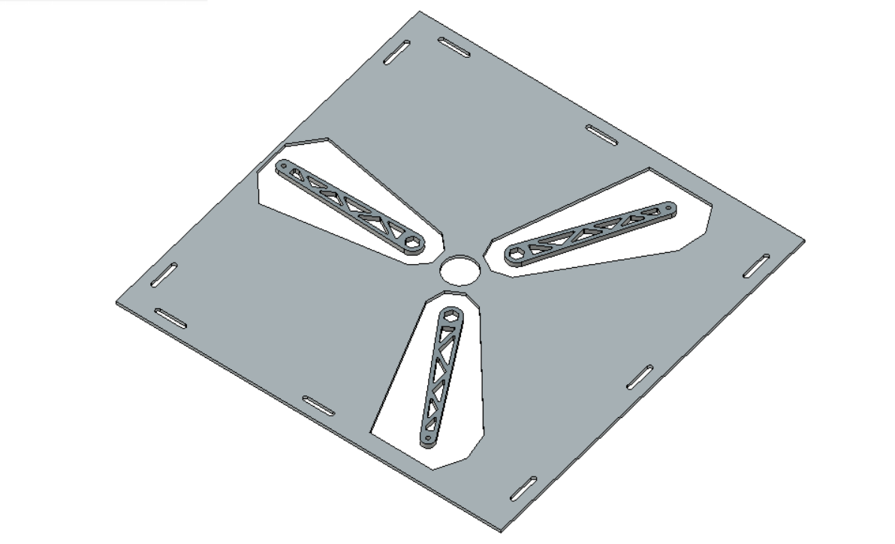
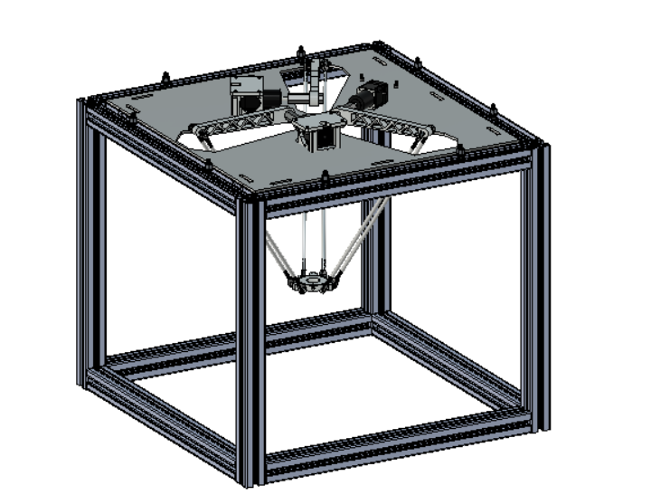
Laser cutting 8mm AA6061
Changes
Single Arm made out of ABS weighted around 50g (100 % in-fill material)
(16mm thick)
Metal arm weighs around 76g (8mm thick)

Slide 3
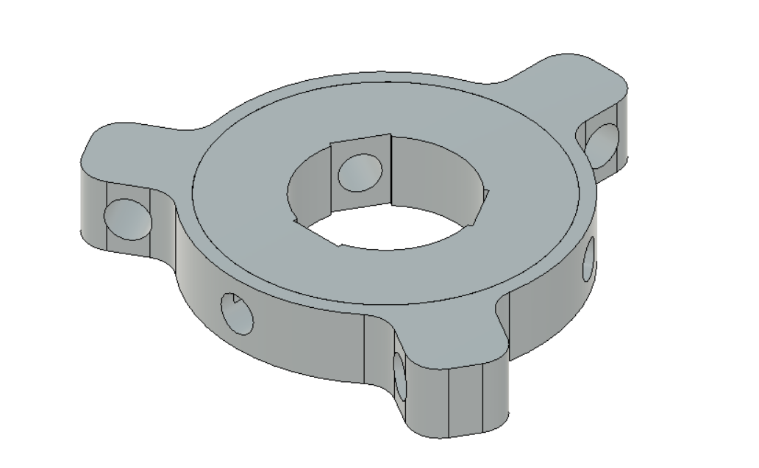
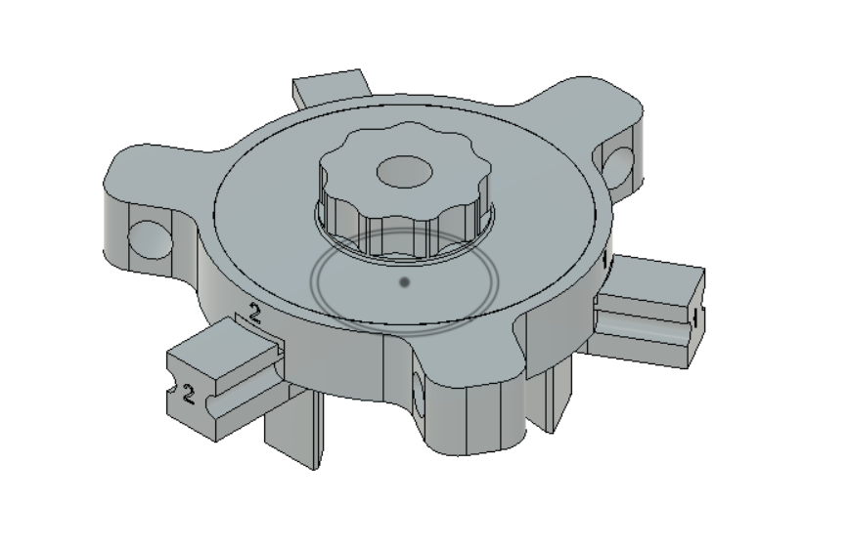
Transducer Holder
Revised Holder
Initial Design

Slide 4
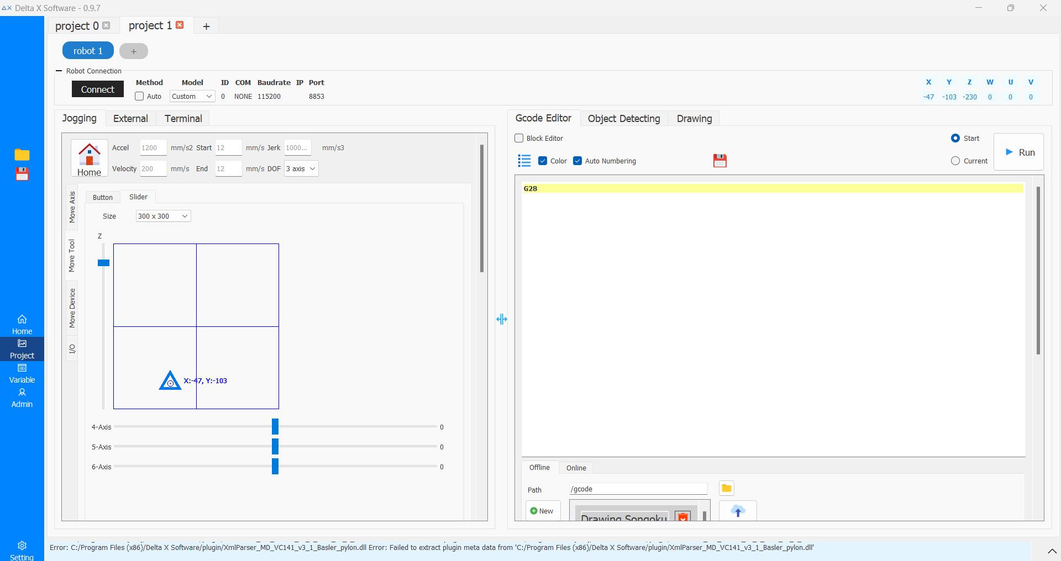
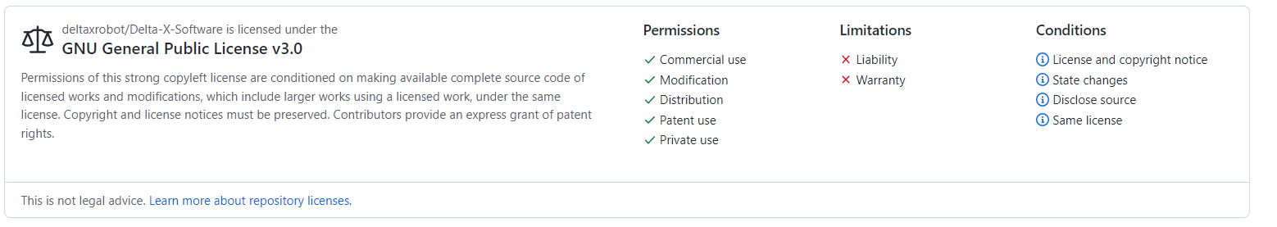
Software
Delta X is company based in Vietnam.
There designs and software are open source
Solution 1: Building On Top of existing software

Slide 5
Software - Control
Path Planning using Python or MATLAB
G – Code Generator
CURRENT LEVEL OF CONTROL
POINT – TO – POINT
As per the plan the probe will have dwell between each point.
IN LEVEL OF CONTROL – CONTINOUS PATH (no dwell)
Interfacing Microcontroller with PC using a Serial Monitor

